Slide 1
Chapter 24: The Role of Architects in Projects
I don’t know why people hire architects and then tell them what to do.
—Frank Gehry

Slide 2
Chapter Outline
The Architect and the Project Manager
Incremental Architecture and Stakeholders
Architecture and Agile Development
Architecture and Distributed Development
Summary

Slide 3
The Architect and the Project Manager
The relationship between the software architect and the project manager (PM) is crucial.
The PM is responsible for the overall performance of the project—keeping it on budget, on schedule, and properly staffed.
To do this, the PM will often turn to the architect for support.
The PM is responsible for the external-facing aspects of the project and the architect is responsible for the internal technical aspects.

Slide 4
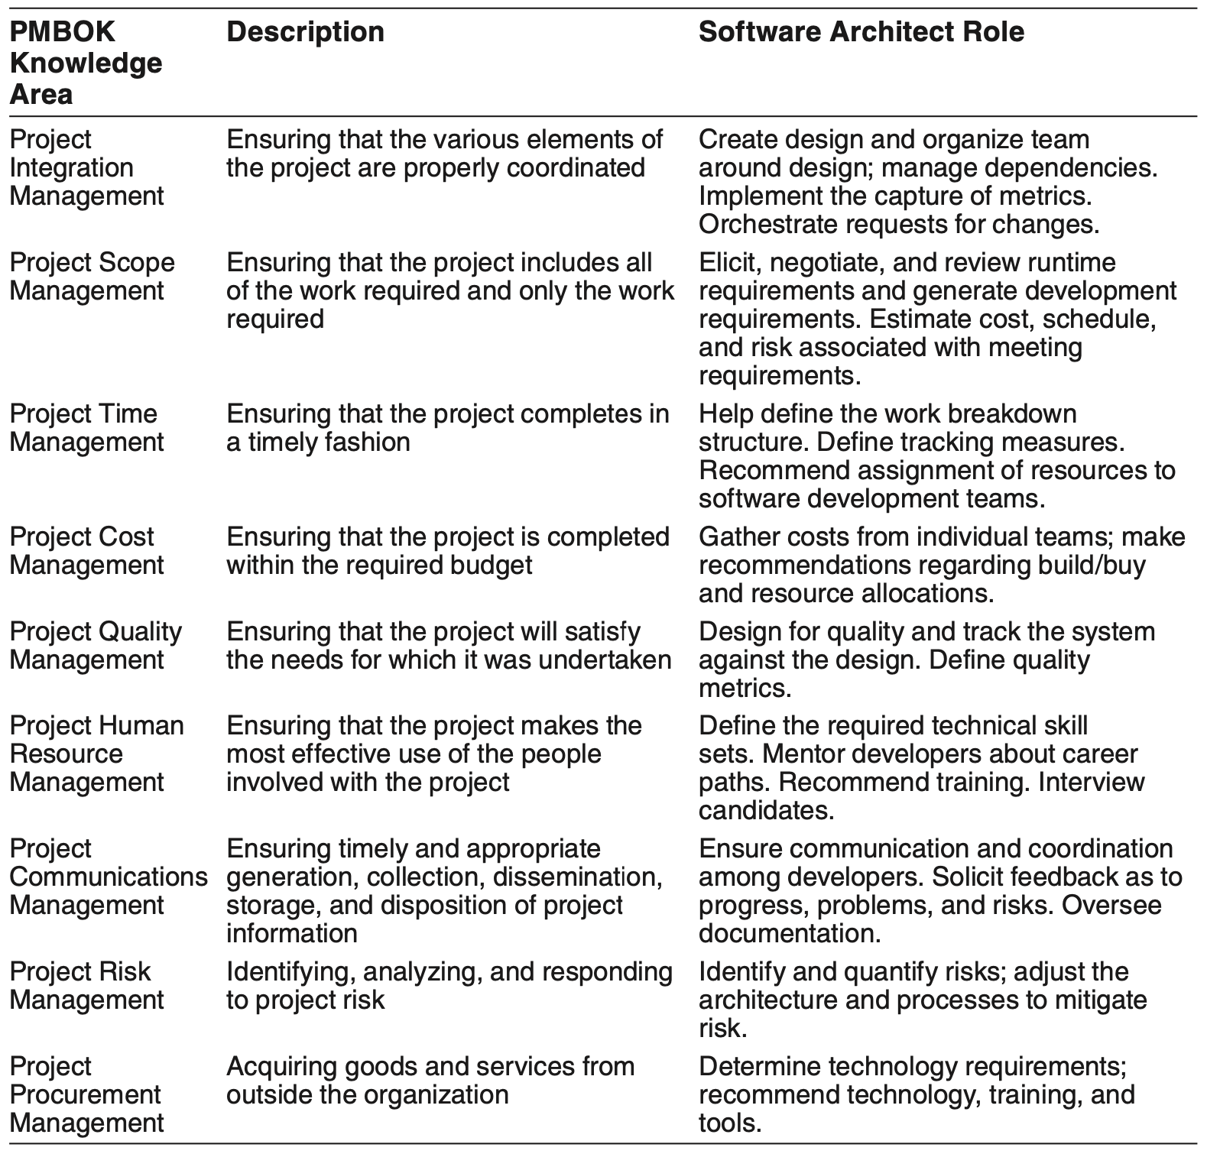
Architect’s Role in Supporting PM Knowledge Areas

Slide 5
Architect’s Role in Supporting PM Knowledge Areas

Slide 6
Recommendations to the Architect
Maintain a good working relationship with the PM.
Be aware of the PM's tasks and concerns, and how you as an architect may be asked to support those tasks and concerns.

Slide 7
Incremental Architecture and Stakeholders
Agile methodologies are built on the pillar of incremental development, with each increment delivering value to the customer or user.
You should expect to develop and release your architecture in increments.
This entails deciding which views to release (out of your planned set) and at which depth.

Slide 8
Incremental Architecture and Stakeholders
Consider these as candidates for your first increment:
A module decomposition structure. This will inform the team structure for the project which must be defined, staffed, budgeted, and trained. The team structure will be the basis of project planning and budgeting.
A module “uses” structure. This will allow increments to be planned, which is critical in any project that hopes to release its software incrementally. Trying to create a system that purposefully supports incremental development is problematic if you don’t plan what exactly the increments will be.
Whichever component-and-connector (C&C) structure(s) best convey the overall solution approach.
A broad-brush deployment structure that at least addresses major questions such as whether the system will be deployed on mobile devices, on a cloud infrastructure, and so forth.

Slide 9
Recommendations to the Architect
Know who your stakeholders are and what their needs are, so that you can design appropriate solutions and documentation.
Work with stakeholders to determine the release tempo and the contents of each project increment.
Your first increment should include module decomposition and uses views, as well as a preliminary C&C view.
Use your influence to ensure that early releases deal with the system’s most challenging QA requirements, thereby ensuring no unpleasant architectural surprises later.
Stage your architecture releases to support those increments and the needs of developers as they work on each increment.

Slide 10
Architecture and Agile Development
Agile development began as a rebellion against development approaches that were rigid and heavyweight with lots of documentation, focused on up-front planning, culminating in a single delivery.
Agilistas advocate focusing on what the customer really wants and providing it in small, testable increments, starting early on.
The key question is this: How much up-front work, in terms of requirements analysis, risk mitigation, and architecture design, should a project undertake?

Slide 11
Architecture and Agile Development
There is no single right answer to this question, but you can find a “sweet spot” for any given project.
The “right” amount of project work depends on several factors: project size, complex functional requirements, highly demanding QA requirements, volatile requirements, degree of distribution of development.

Slide 12
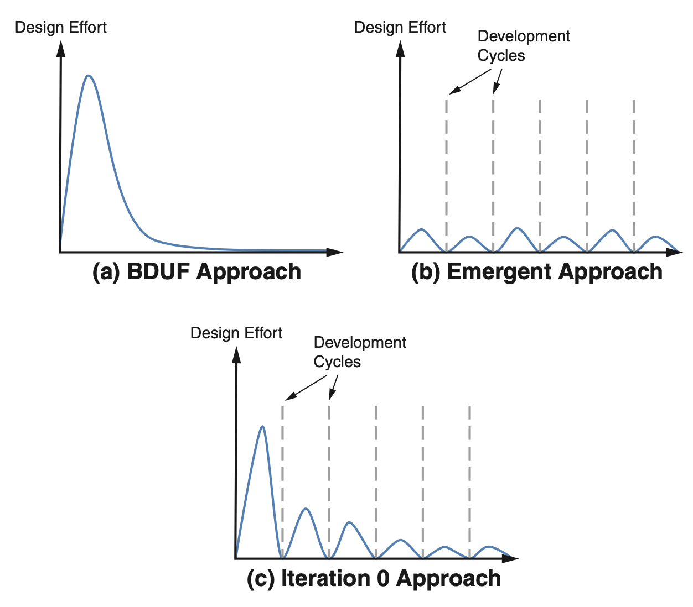
Three Approaches to Architectural Design

Slide 13
Three Approaches to Architectural Design
We recommend the “Iteration 0” approach.
If you have some understanding of the requirements, perform a few iterations of ADD (Chapter 20). Focus on choosing the major architectural patterns (including a reference architecture, if appropriate), frameworks, and components.
This will help you structure the project, define work assignments and team formation, and address the most critical QAs.
When requirements change—particularly driving QA requirements—adopt a practice of Agile experimentation with "spikes".

Slide 14
Three Approaches to Architectural Design
Some Agile doctrine declares that if you aren’t delivering working software, then you aren’t doing anything of value.
Therefore if you’re working on an architecture, then you’re not programming and, therefore, you’re doing nothing of value! Write code, and the architecture will emerge organically.
For medium to large systems, this view has inevitably collapsed under the harsh weight of experience.

Slide 15
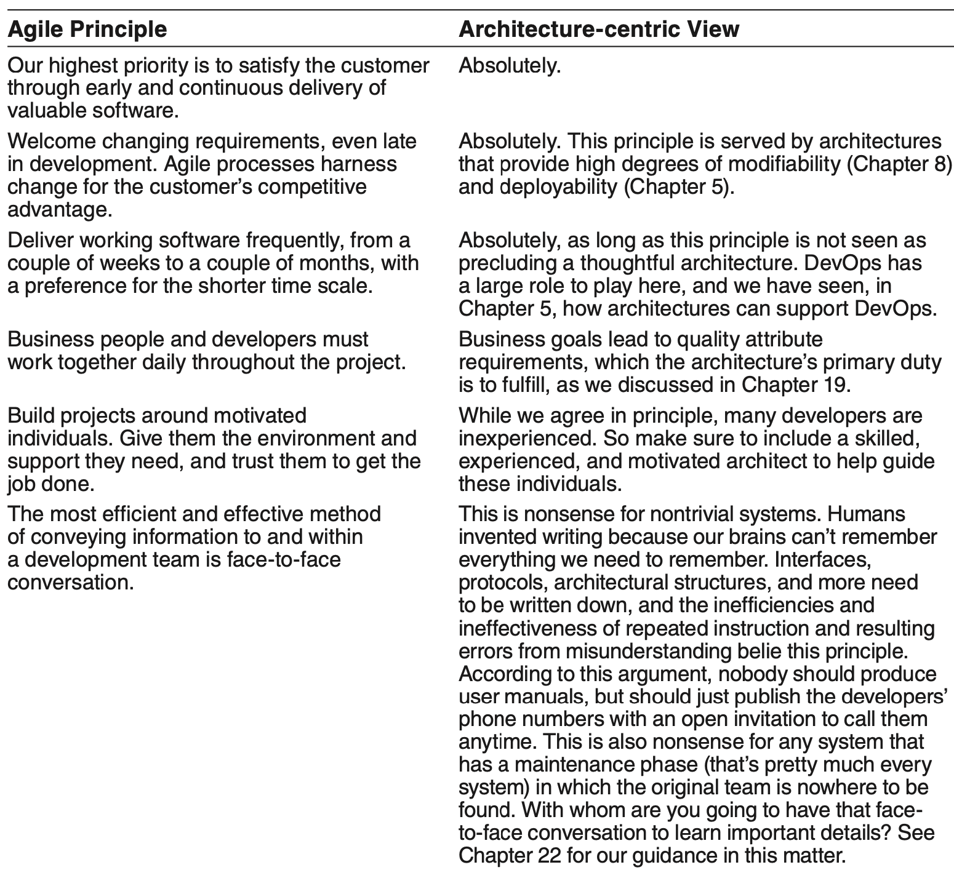
Agile Principles and Architecture-centric Perspective

Slide 16
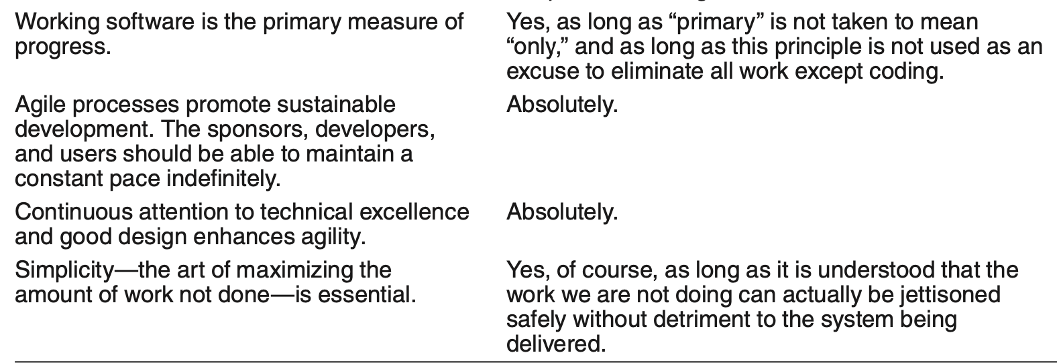
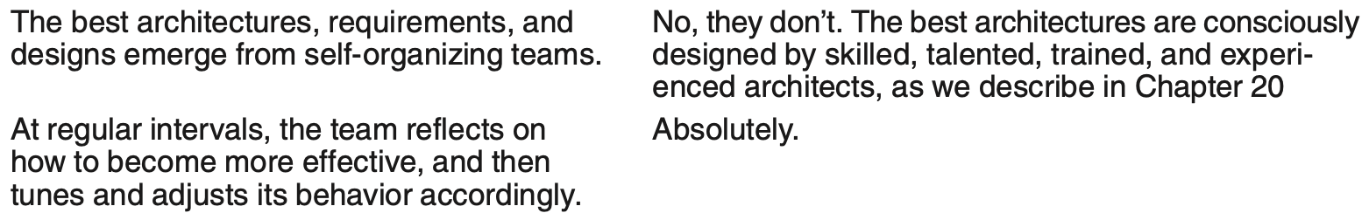
Agile Principles and Architecture-centric Perspective

Slide 17
Agile Architecture and SAFe
One approach to apply Agile at enterprise scale is the Scaled Agile Framework (SAFe).
SAFe provides a set of workflows, roles, and processes to coordinate the activities of many teams, each operating in classic Agile fashion.
SAFe acknowledges the role of architecture. It admits “intentional architecture”: a set of purposeful, planned architectural strategies and initiatives.
And it includes a counterbalancing force called “emergent design”.

Slide 18
Architecture and Distributed Development
Many projects today are developed by distributed teams, possibly outsourced, possibly scattered around the globe.
Distributed development comes with both benefits and challenges, such as lowering costs, leveraging specialized skills and local knowledge of markets.

Slide 19
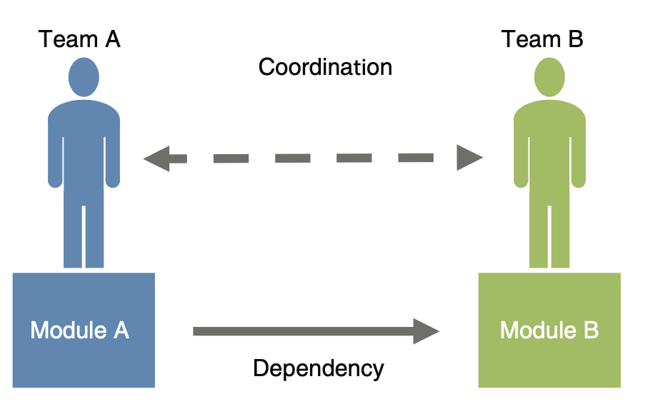
Architecture and Distributed Development
How does distributed development play out on a project?
Assume Module A uses an interface from Module B. In time this interface may need to be modified.
The team responsible for Module B must coordinate with the team responsible for Module A.

Slide 20
Architecture and Distributed Development
Methods for coordination include :
Informal contacts.
Documentation.
Meetings.
Asynchronous electronic communication.

Slide 21
Architecture and Distributed Development
What does this mean for architecture and the architect?
Allocation of responsibilities to teams is more important in distributed development than in co-located development.
Attention to module dependencies takes on added importance: Dependencies among modules owned by distributed teams are more likely to be problematic and should be minimized.
Documentation is especially important in distributed development.

Slide 22
Summary
Architects do their work in the context of a development project; they need to understand their roles and responsibilities from that perspective.
The project manager and the architect have complementary roles: The manager runs the project from an administrative perspective, the architect runs it from a technical perspective. These roles intersect.
Architectures are released in increments that are useful to stakeholders. Thus the architect needs to have a good understanding of the architecture’s stakeholders and their information needs.
Agile methodologies focus on incremental development. Over time, architecture and Agile have become indispensable partners.
Global development creates a need for an explicit coordination strategy that is based on more formal strategies than are needed for co-located development.

